Slide 1
BLOOD BANK MANAGEMENT
Presentation on
SQL Project
Guided by : Prasad Deshmukh sir

Slide 2
Presented by -
Sejal Aware
Prathmesh Pawar

Slide 3
AGENDA
Introduction​
Primary goals
​Purpose and Importance
Database Design Diagram
​​Operations on Table
Business Query
Conclusion

Slide 4
Introduction
The blood bank systems plays a crucial role in healthcare by ensuring the availability of safe and compatible blood for transfusions.
It serves as a centralized repository for collecting, testing, storing, and distributing blood and blood products.
The blood bank system plays a critical role in ensuring the availability and safety of blood for medical treatments and emergencies.

Slide 5
Purpose & importance
The purpose of the blood bank system project is to create a comprehensive and efficient system for managing blood donations, storage, and distribution. The objective of the project include:
Implementing an organized and secure storage system for blood units, ensuring their availability when required.
Streamlining the blood donation process to ensure a steady supply of blood for patients in need.
Faciliting the efficient distribution of blood to hospitals and medical facilities, reducing response time in emergencies.

Slide 6
PRIMARY GOALS
To Provide the blood to all the Patients and fulfill the requirements of patient/hospital.

Slide 7
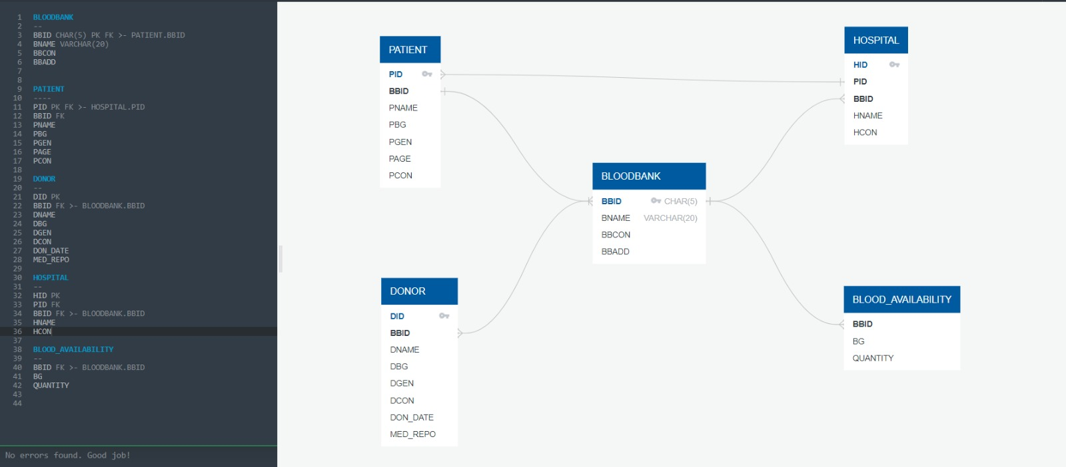
Database Design Diagram

Slide 8
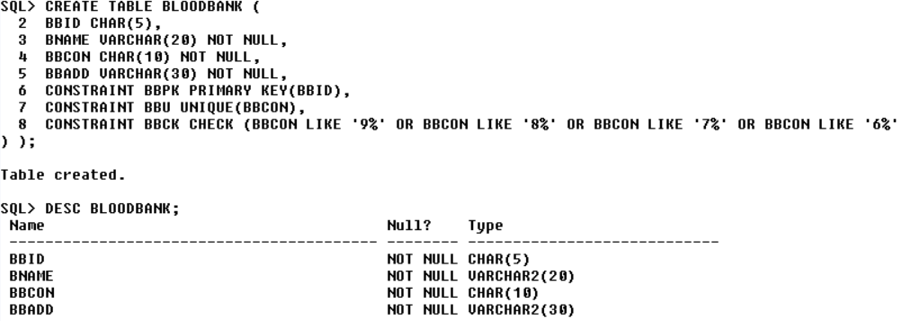
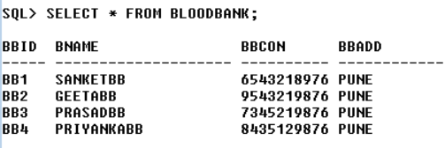

Slide 9
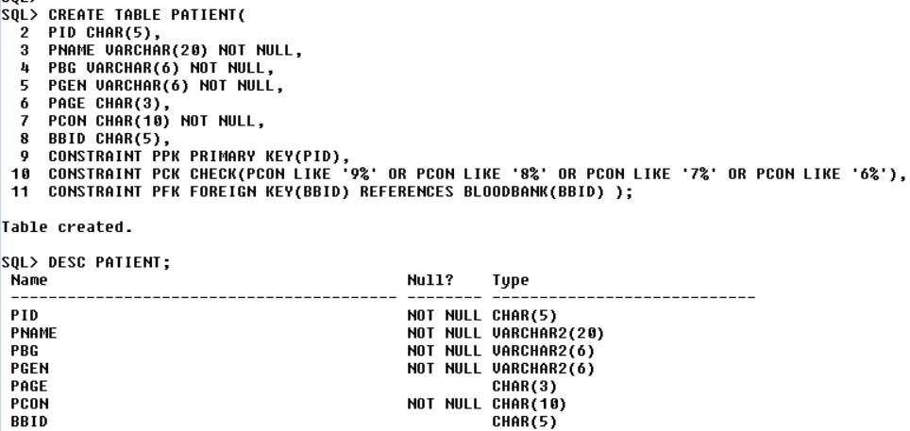
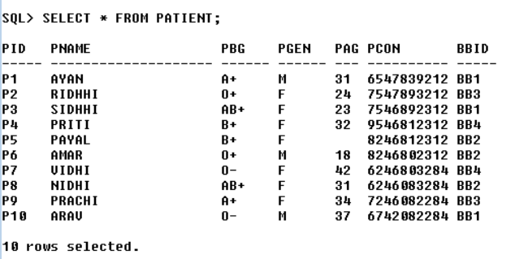

Slide 10
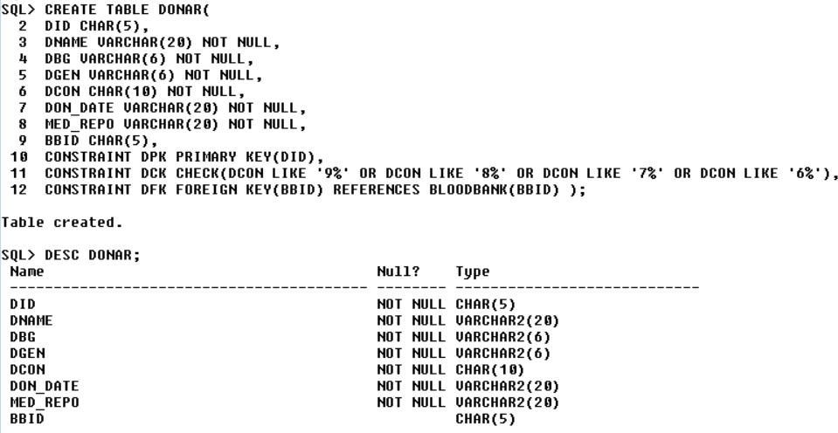
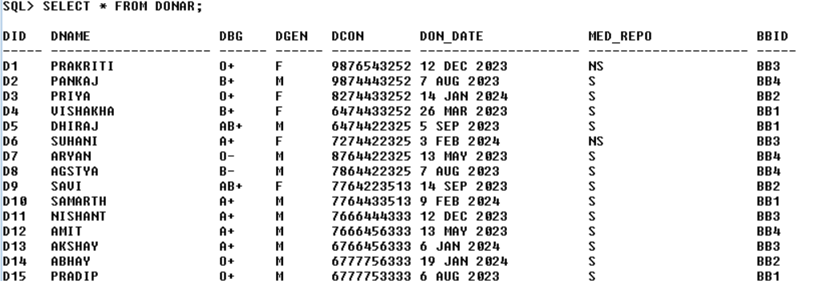

Slide 11
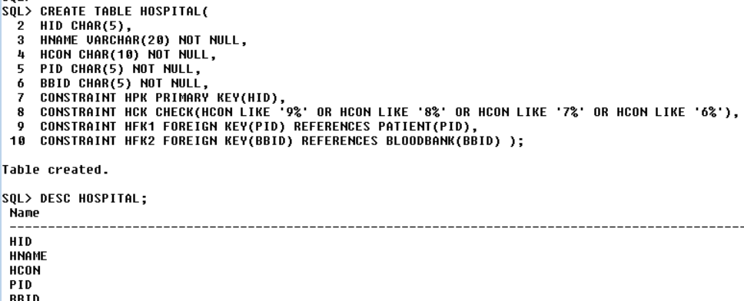

HOSPITAL

Slide 12
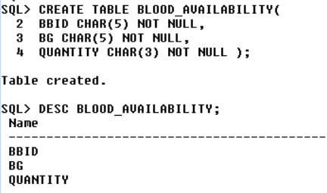
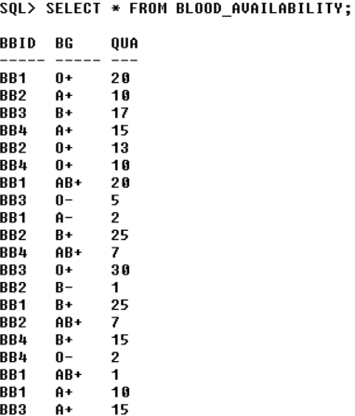
BLOOD AVAILABILITY

Slide 13
BUSINESS QUERIES

Slide 14
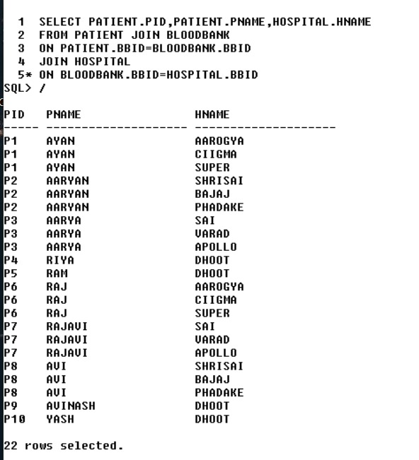

Slide 15


Slide 16
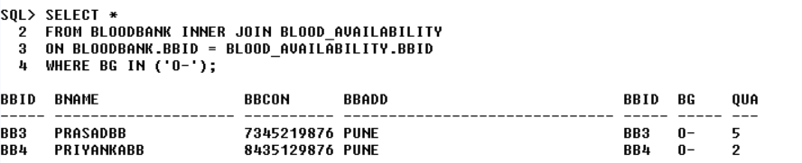

Slide 17


Slide 18
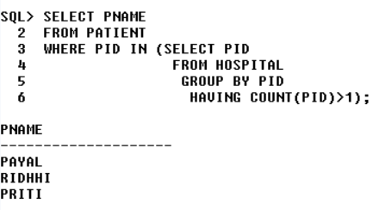

Slide 19
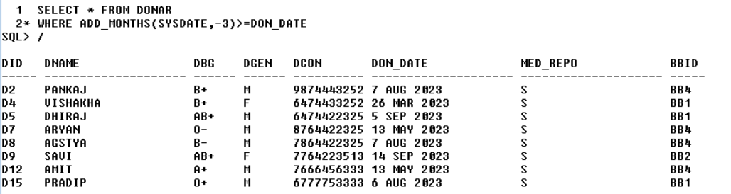
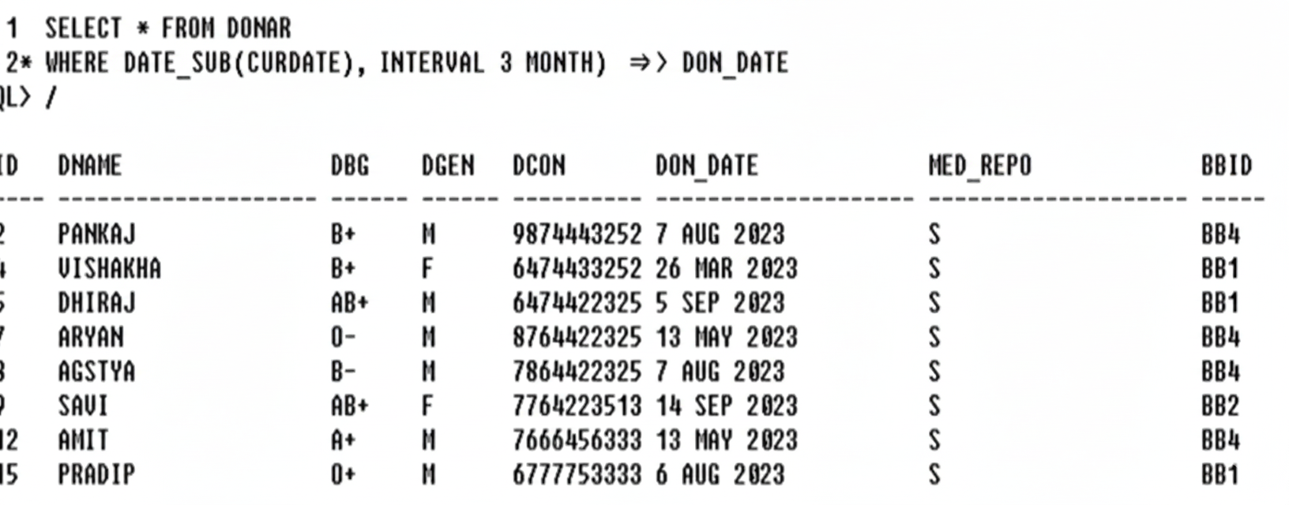

Slide 20
ACHIEVEMENTS
Successfully implemented a BLOOD BANK SYSTEM .
To manage blood donations inventory and distribution.

Slide 21
FUTURE IMPROVEMENTS
Enhance the user interface to improve user experience and more intuitive.
Expand the system to improve more comprehensive tracking and reporting capabilities.

Slide 22
THANK YOU

